Slide 1
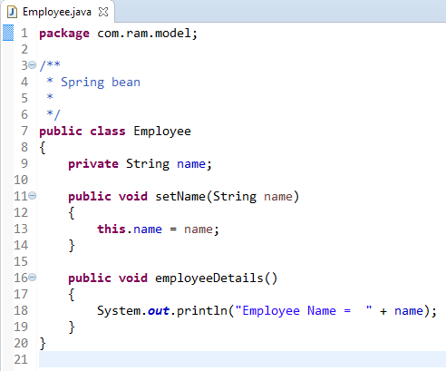
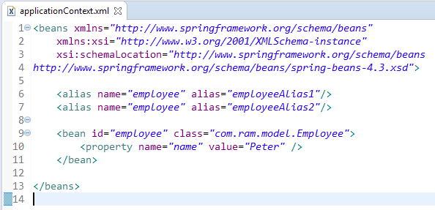
How to access the Spring bean using alias name?
Beans in spring cannot have more than one id but we can give more than one alias to the bean as below.
First parameter inside < alias > tag is alias name, it should be same as the bean id
Second parameter inside < alias > tag is alias, it can be any new name which we want to create as alias.

Slide 2
How to access the Spring bean using alias name?
Employee
What object to instantiate?
What object to configure and how to configure?
The Spring Container
(ApplicationContext/BeanFactory)
applicationContext.xml
Employee
Object
name=“Peter”
Create the employee object.
Configure the employee object.
Manage employee object complete life cycle from creation till destruction.

Slide 3
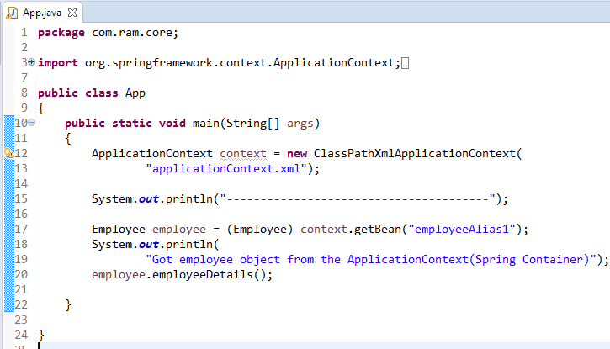
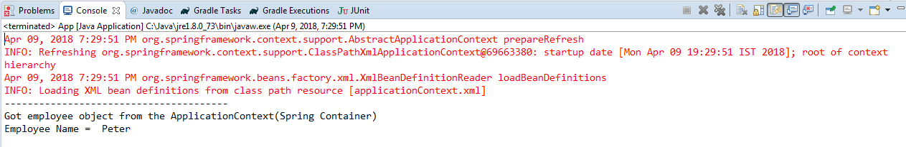
How to access the Spring bean using alias name?
Here we have loaded the employee bean using its alias name and we can use it without worrying about its creation.

